Slide 1
Data-Driven Insights for Digital Marketing Campaigns
Project created by: Karthik N
Date Created: 27-May-2026
Batch: BMAI-C-WD-E-B33

Slide 2
PROJECT OBJECTIVE
Analyze marketing performance data to identify key performance metrics like revenue drivers, audience segments, and optimization opportunities and making data-driven decisions to improve client ROI and enhance overall campaign performance.

Slide 3
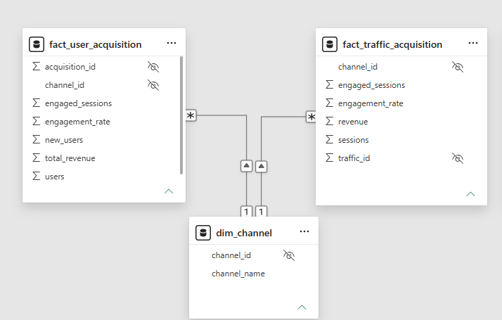
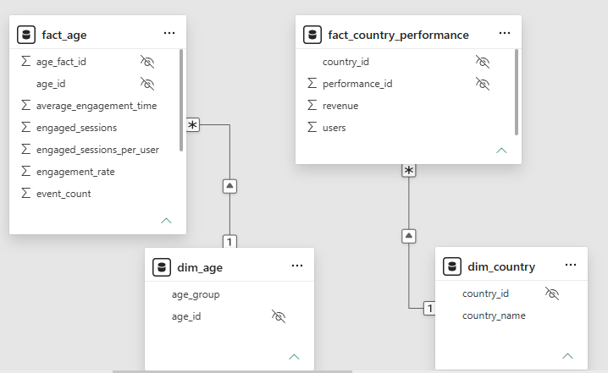
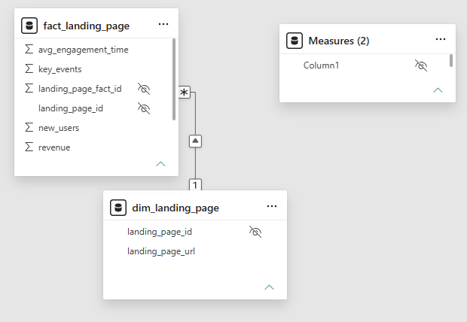
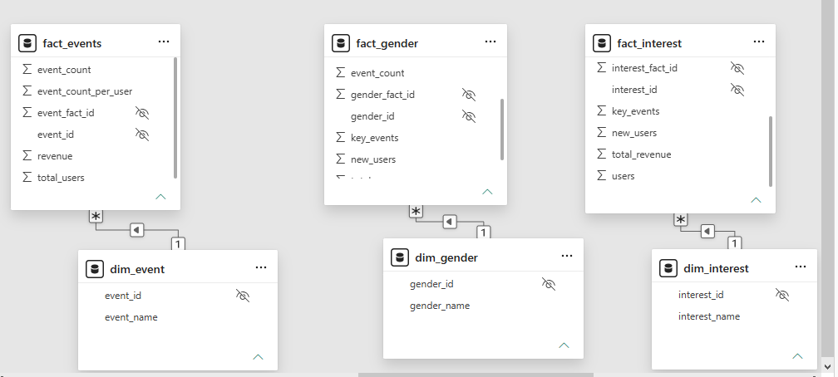
Data Modelling -
Galaxy Schema
8 Fact Tables
7 Dimension Tables

Slide 4
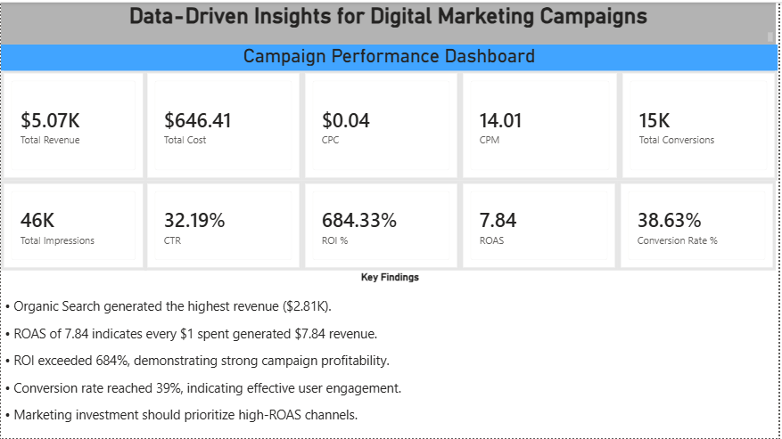
Executive Dashboard

Slide 5
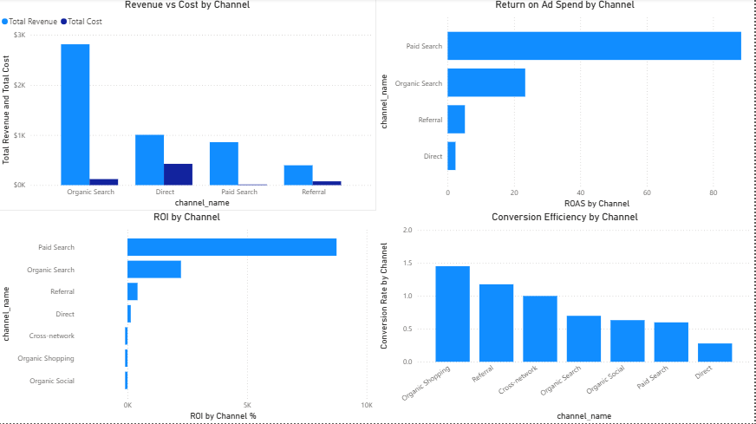
Channel intelligence

Slide 6
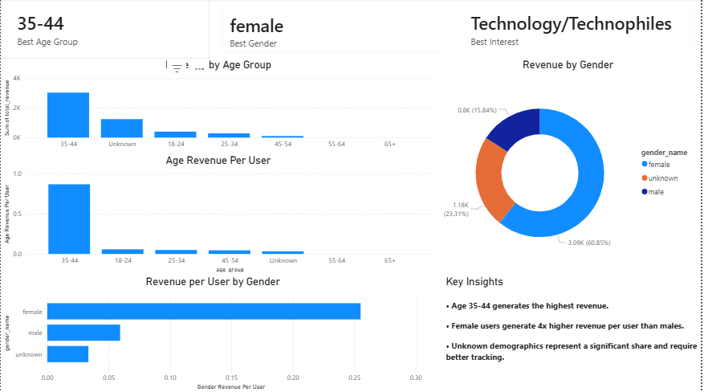
Audience INTELLIGENCE

Slide 7
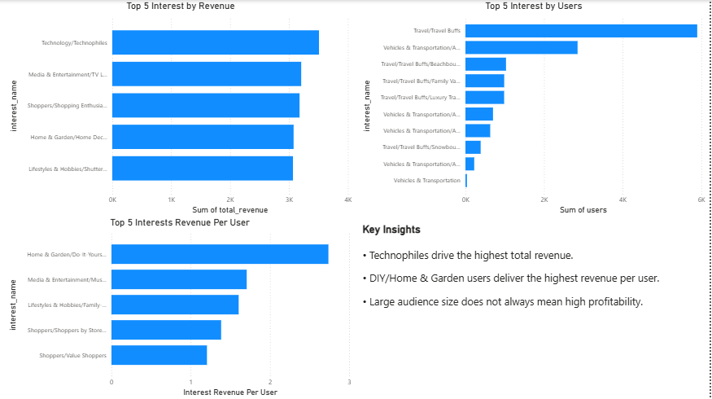
INTEREST SEGMENTATION

Slide 8
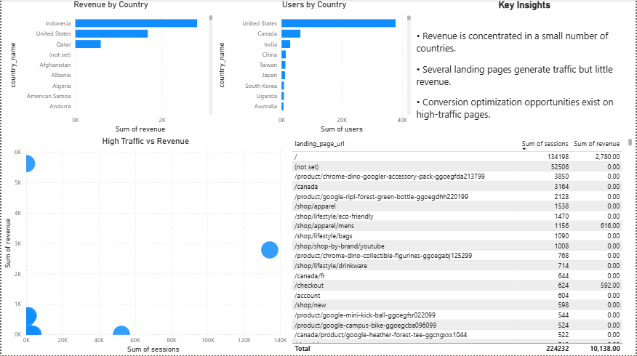
GEOGRAPHY & LANDING PAGE ANALYSIS

Slide 9
FINAL KEY INSIGHTS
Organic Search generated the highest revenue ($2.81K) and contributed over 55% of total revenue.
Campaigns achieved a strong ROI of 684% and ROAS of 7.84x.
Paid Search delivered the highest return on ad spend among paid channels.
The campaign generated 46K impressions and 15K conversions, indicating strong audience engagement.
Revenue and profitability were concentrated in a few high-performing channels.

Slide 10
Business Recommendations
Increase investment in Organic Search to sustain revenue growth.
Scale high-ROAS Paid Search campaigns to maximize returns.
Optimize or reduce spending on underperforming channels.
Improve landing pages and conversion funnels to increase conversion rates.
Monitor ROI, ROAS, CTR, CPC, and Conversion Rate as primary campaign success metrics.

Slide 11
CONCLUSION
The campaign delivered strong marketing performance, generating $5.07K revenue from $646 spend, resulting in 684% ROI and 7.84x ROAS.
Organic Search emerged as the primary revenue driver, while Paid Search demonstrated strong efficiency. By focusing on high-performing channels and continuously optimizing campaign performance, the business can further improve marketing ROI and profitability.
Data-driven marketing decisions can significantly improve campaign efficiency, maximize returns on advertising spend, and drive sustainable business growth.

